Slide 1

MINI PROJECT
BATCH (B27)
CSE DEPARTMENT
FACE RECOGNITION APPLICATION FOR MASK DETECTION
PRESENTED BY:
L.HRITHIK -19H51A0577
S. JOSPHINE- 19H51A0586
DISHA SAINI-19H51A0590
PROJECT GUIDE:
Dr. P. ANJUSHA

Slide 2
TABLE OF CONTENTS:
ABSTRACT
INTRODUCTION
OBJECTIVE
EXISTING SOLUTION
PROPOSED SYSTEM DESIGN
SYSTEM REQUIREMENTS
METHODOLOGY
IMPLEMENTATION
ADVANTAGES
OUTPUT
CONCLUSION
REFERENCES

Slide 3
ABSTRACT:
COVID-19 pandemic has rapidly affected our day-to-day life-disrupting world trade and movements. Wearing a protective face mask has become a new normal. Therefore, face mask detection has become a crucial task to help global society.
People are now required to wear facial protection at all times. However, there have been several reports of people breaking the regulations and without wearing masks.
This paper presents a simplified approach to achieve this purpose using some basic Machine Learning packages like TensorFlow, MobileNet, Keras, and OpenCV.

Slide 4
INTRODUCTION:
The trend of wearing face masks in public is rising due to the COVID- 19 corona virus epidemic all over the world. Before Covid-19, People used to wear masks to protect their health from air pollution. While other people are self-conscious about their looks, they hide their emotions in the public to hide their faces.
Here we introduce a facemask detection model that is based on computer vision and deep learning. The proposed model can be integrated with Cameras by allowing the detection of people who are wearing masks not wearing face masks. The model is integration between deep learning and classical machine learning techniques with Open cv, Tensor flow and Keras. We will achieve the highest accuracy and consume the least time in the process of training and detection.

Slide 5
OBJECTIVE:
The objective of this project is to create an application that identifies the presence of a face mask on human faces in live streaming videos and photographs.

Slide 6
EXISTING SOLUTIONS:
The existing system deals with CNN (convolution neural network) in the face mask detection models, they use clustering, classification, and max pooling to train the machine on what is what. The CNN trains the machine with the help of dataset, around 20% of the images in dataset are used to train the machine and the remaining 80% is used for testing the results. The face mask detection model empathizes with the problems faced by people around the globe due to COVID-19. This system helps in a small way to stop the pandemic from spreading and festering into our lives further. The Person Identification model or the face recognition model as it is popularly called uses the face recognition library of python to compare images by similarity detection technique.
Drawbacks in existing system
The major limitations of existing schemes are as follows: -
CNN used in existing system are slow and resource hungry, which makes the training process slow.
The existing system does not detect faces from all angles.

Slide 7
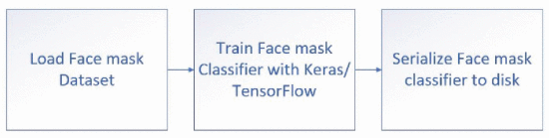
PROPOSED SYSTEM DESIGN
The design process for face mask detection is ,the data set for the face masks is loaded into the training script. The data is then pre-processed after. For the training purpose, a Keras/TensorFlow library named MobileNet_V2 is used, this classifier remains a better version for the CNN neural networks as in this the training procedure is relatively faster with a minimal decrease in accuracy. To monitor the training process in this model, the matplotlib library is used to plot a graph.

Slide 8
SYSTEM REQUIREMENTS:
HARDWARE REQUIREMENTS:
PROCESSOR : DUAL CORE 2
RAM : 4GB DD RAM
HARD DISK : 250 GB
SOFTWARE REQUIREMENTS:
OPERATING SYSTEM : WINDOWS 7/8/10
PLATFORM :VISUAL STUDIO CODE
PROGRAMMING LANGUAGE :PYTHON,HTML
FRONT END :VISUAL STUDIO CODE
LIBRARIES: TENSOR FLOW, KERAS, Mobile Net, Open CV.

Slide 9

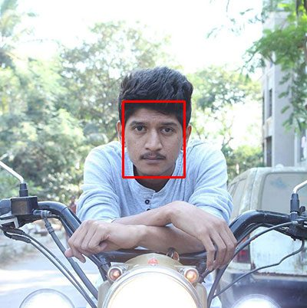
FACE DETECTION METHODOLOGY:
To build a COVID-19/ Corona virus pandemic face mask dataset, we’ll first start with a photograph of someone not wearing a face.
The next step is to apply face detection. Here we’ve used a deep learning method to perform face detection with OpenCV.

Slide 10

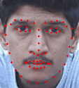
METHODOLOGY:
The next step is to extract the face with OpenCV and NumPy slicing.
Then, we detect facial landmarks using dlib so that we know where to place a mask on the face.

Slide 11

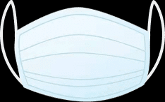
An example of a COVID-19/Corona virus face mask/shield. This face mask will be overlaid on the original face automatically since we know the face landmark locations.
In this figure, the face mask is placed on the person’s face in the original frame. It is difficult to tell at a glance that the COVID-19 mask has been applied with computer vision by way of OpenCV and dlib face landmarks.

Slide 12
DATASET:
To create dataset, Taking normal images of faces
Then creating a custom computer vision Python script to add face masks to them, thereby creating an artificial (but still real-world applicable) dataset.
Facial landmarks allow us to automatically infer the location of facial structures, including:
Eyes
Eyebrows
Nose
Mouth
Jaw line

Slide 13
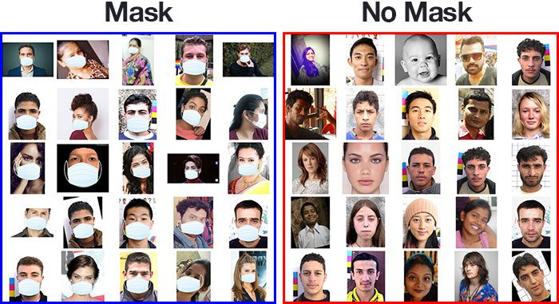
Our COVID-19 face mask detection dataset
A face mask detection dataset consists of “with mask” and “without mask” images. We will use the dataset to build a COVID-19 face mask detector with computer vision and deep learning using Python, OpenCV, and TensorFlow/ Keras.

Slide 14
IMPLEMENTATION:
We have four major steps
Datasets Collecting : We collect number of data sets with face mask and without masks. we can get high accuracy depends on collecting the number of images .
Datasets Preprocessing and Extracting: The data is preprocessed using TensorFlow and features are extracted using mobile net v2 of mask and no mask sets
Models Training: We will train the model using Keras. Test size is 20% and training size is 80%.
Face Recognition Model: Empty NumPy arrays are used to analyze images for their locations (ROI), their encodings (The ROI coordinates). OpenCV was used to read frames and display data in the frames like the predictions which includes the accuracy of prediction and text “MASK” or “NO MASK” with percentage of accuracy.

Slide 15
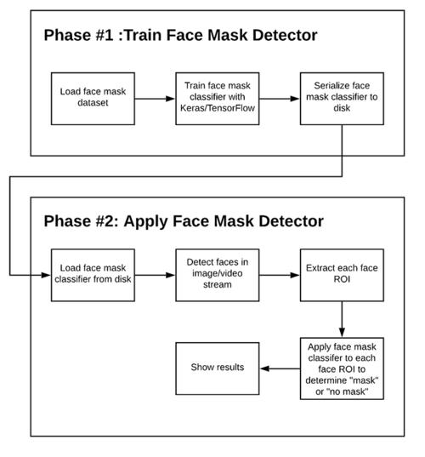
TWO-PHASE FACE MASK DETECTOR DIAGRAM:

Slide 16
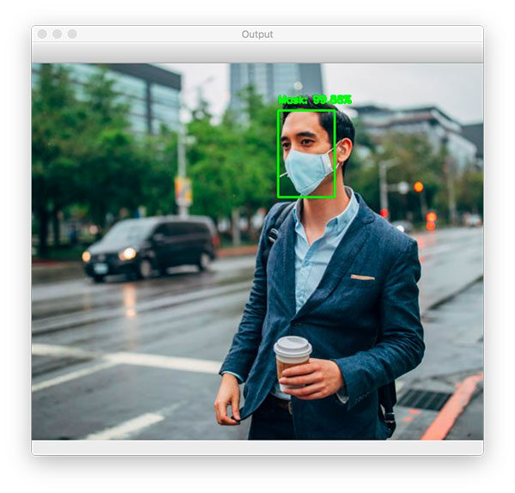
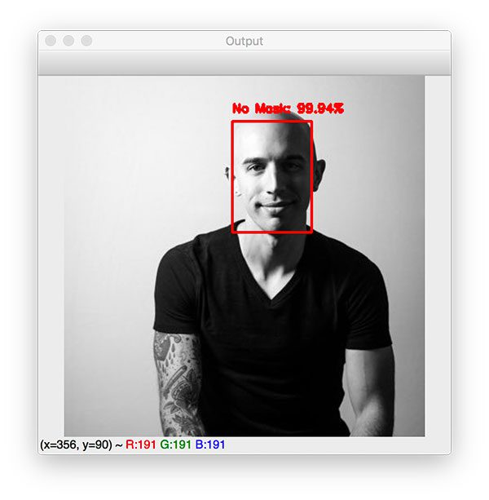
OUTPUT:
face mask detector correctly labeled this image as Mask.
face mask detector has correctly predicted No Mask.

Slide 17
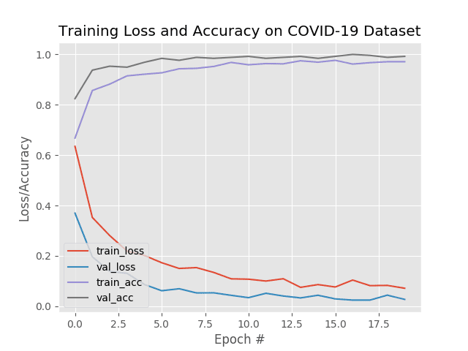
COVID-19 face mask detector training accuracy/loss curves demonstrate high accuracy and little signs of over fitting on the data. We’re now ready to apply our knowledge of computer vision and deep learning using Python, OpenCV, and TensorFlow/Keras To perform face mask detection. we are obtaining ~99% accuracy on our test set.

Slide 18
ADVANTAGES:
  Manual monitoring is very difficult for officers to check whether the people are wearing a mask or not. So in our technique, We are using the webcam to detect people’s faces.
  Can be implemented in various locations and electronic devices such as CCTV, embedded systems, mobile phones, and even in web browsers.

Slide 19
CONCLUSION:
The work proposed in the system focuses on the important challenge faced by the world during the current times due to the ongoing COVID-19 pandemic. The proposed research work has successfully recognized peoples who have wearing masks or not. Also, this research work has successfully detected multiple people without wearing a mask or with a mask in a single frame of video. This third eye technology focuses on the complicated work of detecting multiple people at once to ensure that people stay safe in these troubled times by ensuring that they follow the guidelines which are issued by the government.

Slide 20
REFERENCES:
B. QIN, D. LI, identifying facemask-wearing condition using image super-resolution with classification network to prevent covid-19 (2020)
H. Li, Z. Lin, X. Shen, J. Brandt, G. Hua, in Proceedings of the IEEE conference on computer vision and pattern recognition (2015), pp. 5325–5334
W. Liu, Z. Wang, X. Liu, N. Zeng, Y. Liu, F.E. Alsaadi, A survey of deep neural network architectures and their applications, Neurocomputing 234, 11 (2017)
Yang xin, Lingshuang Kong, Zhi Liu, Yuling Chen, Yanmiao Li, Hongliang Zhu, et al., "Machine Learning and Deep Learning Methods for Cyber security", IEEE Access, vol. 6, pp. 35365-35381, May 2018.

Slide 21
THANK YOU

